Slide 1
GROUP 10
ICT Department
Level 8 year 4 IT
Academic year 2025-2026
Dada Mining and Data Warehousing -FA2
GROUP MEMBERS
IMANIRUMVA Olivier
NKIZINGABO Philbert
UWIMANA Diane
Rwanda Polytechnic | Huye College

Slide 2
Multi-Campus Education Data
Preprocessing Pipeline
Our work was to build a reliable analytics dataset by integrating student, course, and assessment data from multiple campuses (Huye, Kigali, Musanze). Transform raw, messy data into a clean, standardized gold dataset ready for reporting and machine learning applications.

Slide 3
Key Objectives
1. Integrate data from at least 3 campuses with different export formats
2. Handle missing values, duplicates, outliers, and inconsistent formats
3. Build a preprocessing pipeline converting raw files into clean gold dataset

Slide 4




Creating data sources-data Requirements
Students
Courses
Assessments
Student profile data including ID, name, gender, DOB, program, level, intake year
Course catalog and enrollment data with course codes, titles, credits
Assessment results including marks, grades, credits, attendance rates
Intentional Data Quality Issues that must to include in data sources
• Missing values (phone, gender, DOB, marks)
• Duplicates (student IDs, repeated results)
• Outliers (marks > 100, negative marks, unrealistic GPA)
• Inconsistent formats (dates, capitalization, course codes)
• Noisy data (spaces, special characters, typos)

Slide 5
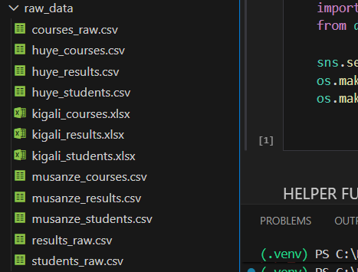
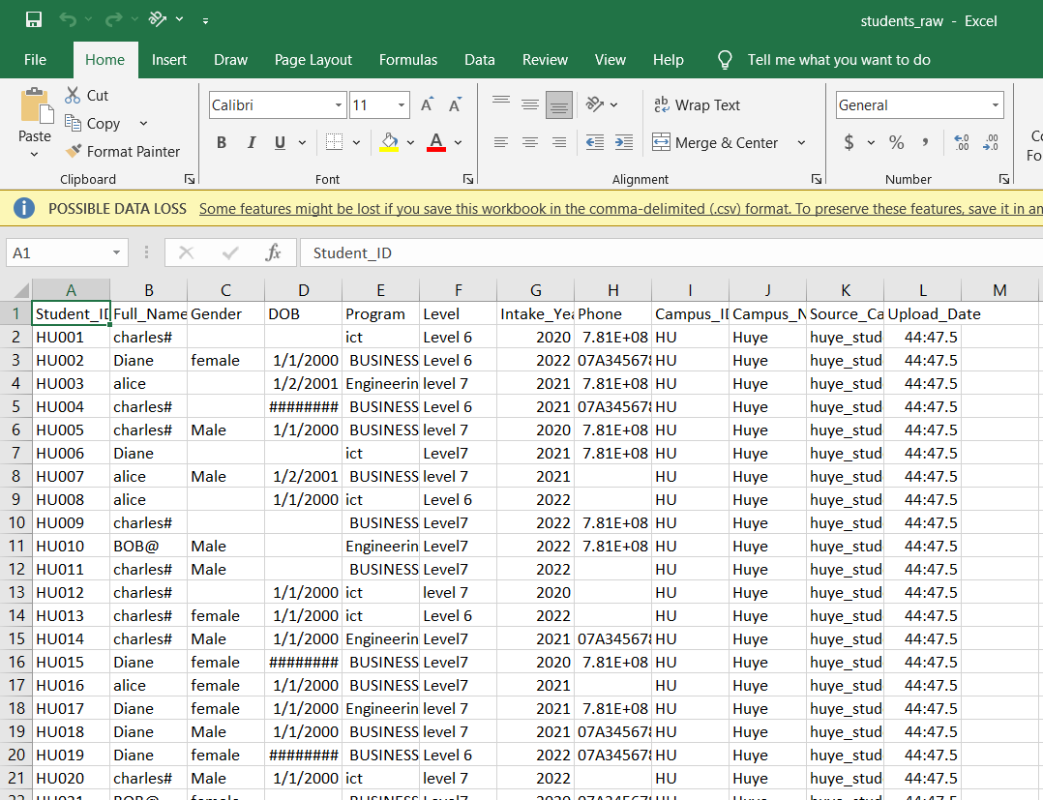
Outputs after creating dirty data sources

Slide 6





Data Preprocessing Pipeline
1
Data Collection
Load & Profile
2
Data Cleaning
Fix Issues
Phase 6
3
Transformation
Feature Engineering
Scale & Encode
Create 8+ engineered features:
4
Integration
• Date-time features
• Performance aggregations
• Risk flags
Merge Datasets
5
Reduction
Remove Irrelevant

Slide 7
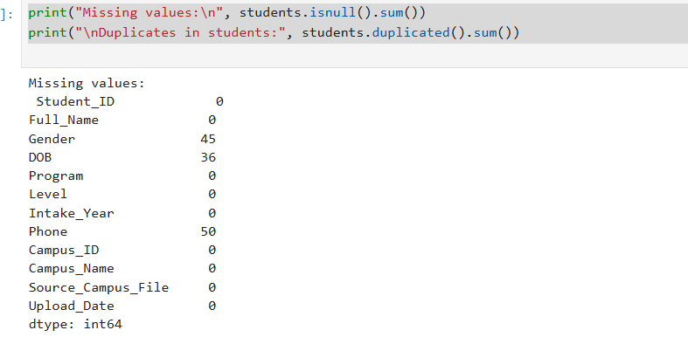
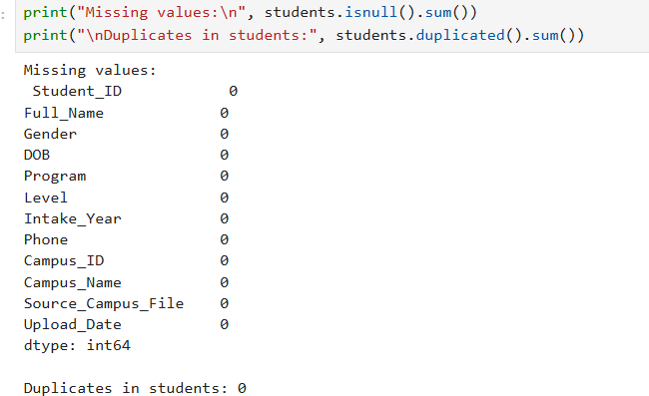
Example of data issue and handling
Missing values After handling

Slide 8
Data integration

Slide 9
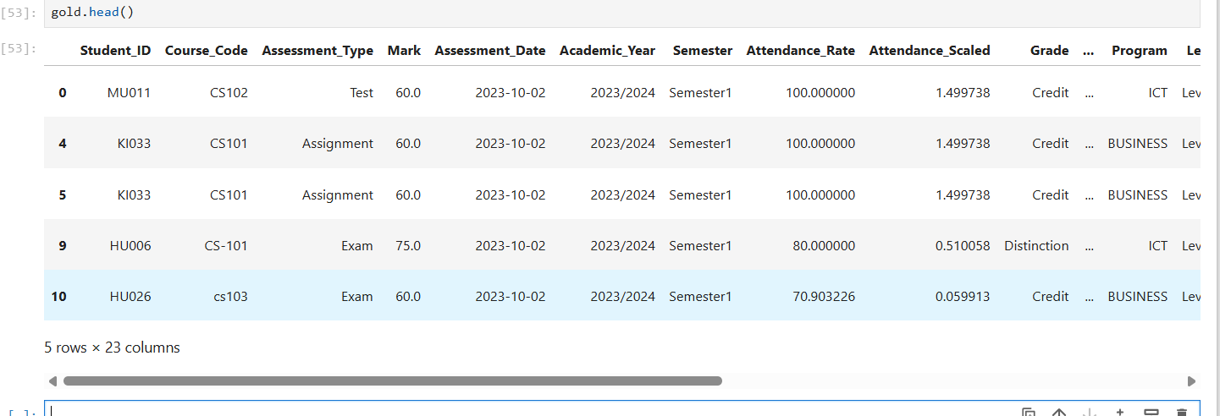
Final Output: Gold Dataset

